Slide 1
SofeHer: An Intelligent AI-Driven Women Safely
@ SofeHer Platform
Plofform with Smart Journey Monitoring & Proactive Emergency Response
A proactive web application intepratinp real—time telemetry. spatial risk analysis, dynamic check—ins, and automated multi—
tier emergency orchestration.
Batch Identifier
Project Guide
B. Usha Lalitha - 239X1A0504
J. Shalini- 249X5A05U1
G. Deekshitha- 239X1X0527
Batch No. B15
P. Sunanda

Slide 2
Project Abstract
Ex E c uTlVE SU M¥4ARY
•=••
Women safety during travel and unpredicted emergencies remains a persistent challenge due to delayed distress signals, lack of real-time monitoring, and reliance on manual panic triggers. The proposed platform, SafeHer, introduces an intelligent web-based women safety ecosystem designed to transition personal security from reactive distress calling to proactive threat mitigation. By incorporating smart journey monitoring and Al-driven risk detection, SafeHer continuously evaluates transit parameters, deviations, and missed check-in responses against contextual safety baselines. Upon identifying elevated risk levels, the platform automatically triggers an multi-tiered emergency response mechanism, disseminating verified real-time coordinates, digital black box logs, and route telemetry to designated contacts and community assistance networks. Ultimately, SafeHer empowers users and emergency responders with immediate situational awareness to minimize response latency during critical incidents.
Saf eHer: AI-Driven Women Safety Platform

Slide 3
Introduction & Domain Need
PROB LE M STAT EME NT & MOTI VAT IO N
Context
A Travel Vulnerabilities
Women face heightened security risks during late-night commutes, isolated transit routes, and unfamiliar travel environments.
Conventional System Deficiencies
Existing safety applications rely heavily on manual SOS button triggers, which are impossible to press during sudden physical threats.
Imperative for Proactive Safeguards
Web-Based Accessibility Paradigm
Shift priority from post-incident panic alerts toward continuous monitoring that detects threats before escalation occurs.
SafeHer operates as a high-availability web platform, eliminating app store dependencies and ensuring cross—device compatibility.
@ Integrated AI & Telemetry Fusion
Synthesizes real-time geolocation tracking, dynamic geofenced safety zones, scheduled check-ins, and predictive AI risk scoring into a unified response hub.
Safe Her: Al- Driven Women Safety Platf orm

Slide 4
Proposed System &Core Features
SYST EM CAPAB ILlTl ES
Functional Scope
1. Journey Monitoring
Real—time GPS tracking along selected travel routes.
2. Emergency Check-ins
Periodic prompts verifying user safety state.
3. Safe Zones
Geof ence d alerts for designated high/low safety corridors.
4. Digital Safety Twin
Virtual state avatar mirroring user live status.
5. Emergency Block Box
Immutable event logs recorded prior to SOS.
6. Hidden SOS Discreet non—visual
emergency trigger option.
7. Reverse Tracking
Allows authorized guardians to trace route back.
8. Emergency Contact Alerts
Instant SMS/Web push notification dispatch.
9. Vehicle Data Support
Logs cab/license plate info for journey reference.
10. Volunteer Ne+work
Alerts registered nearby community helpers.
CORE FLOW
User Interface
SafeHer Web Platform
AI + Telemetry
Risk Analysis
Emergency Response
Safe Her: Al- Driven Women Safety Platf orm

Slide 5
Technologies & Implementation Roadmap
TE CHNICAL STAC K
Archifecfure Stock
Layer / Subsystem Technologies Selected Functional Purpose
Frontend Client
React.js, Vite, HTMLS, CSS3, JS (ES6+),
Tailwind CSS
Responsive web dashboard, live tracking UI, check-in prompts.
Implemented
Backend API
Service
Java 17, Spring Boot, RESTfuI APIs, Spring Security
Core business logic, session control, spatial workflow routing.
Implemented
Data Persistence
PostgreSQL/ Supabase (Spatial Extensions)
Relational schema for profiles, black box logs, &
route history.
implemented
AI & Intelligence
Python-based ML risk model, NLP alert generator
Evaluates travel anomalies, missed responses, &
generates alerts.
Planned
Maps &
Telemetry
HTMLS Geolocation API, OpenStreetMap/ Google Maps API
Real-time coordinates capture, map rendering, route geofencing.
Implemented
Security Layer
JSON Web Tokens(JWT), Role-Based Access
Control(RBAC)
Stateless authentication, encryption, and secure REST endpoints.
Implemented
Saf eHer: AI -Driven Women Safety Platf orm

Slide 6




High-Level System Architecture
SYST EM BLUE PRINT
Sysfem Design
User Web Browser
Spring Boot API
JWTAuth Layer REST Controllers
AI / Risk Module
Rsk Asse ssment Anom ay Logic
PostgreSQL/ Supabase
User Records & Emerpe ncy Logs
Re act Vite UI Taiwind CSS
Geolocation & Maps API Notification Gateway Volunteer Support Hub
Safe Her: Al-Driven Women Safety Platf orm

Slide 7
ImplementationI•IethodoIogy & Flow
EX EC UTION WORK FLOW
Process Flow
Stepl
User Auth
Secure JWT Lopin
Step 2
Step 3 Start Journey Enable Live Tracking
Step 4 GPS Telemetry Stre am Location
Coordinate s
Step S Zone Audit
Evaluate Geof ences
Preferences
Add Emergency Contacts
›
y
Black Box Log
Persist Audit Trail
SOS Trigger
Notify Emergency Hub
Step 7 Check-in Prompts
Dete ct Unre sponsive State
Step 8 Risk Escalation
Activate SOS Protocol
Step 6
AI Risk Scoring
Detect Deviations
Safe Her: Al-Driven Women Safety Platf orm

Slide 8
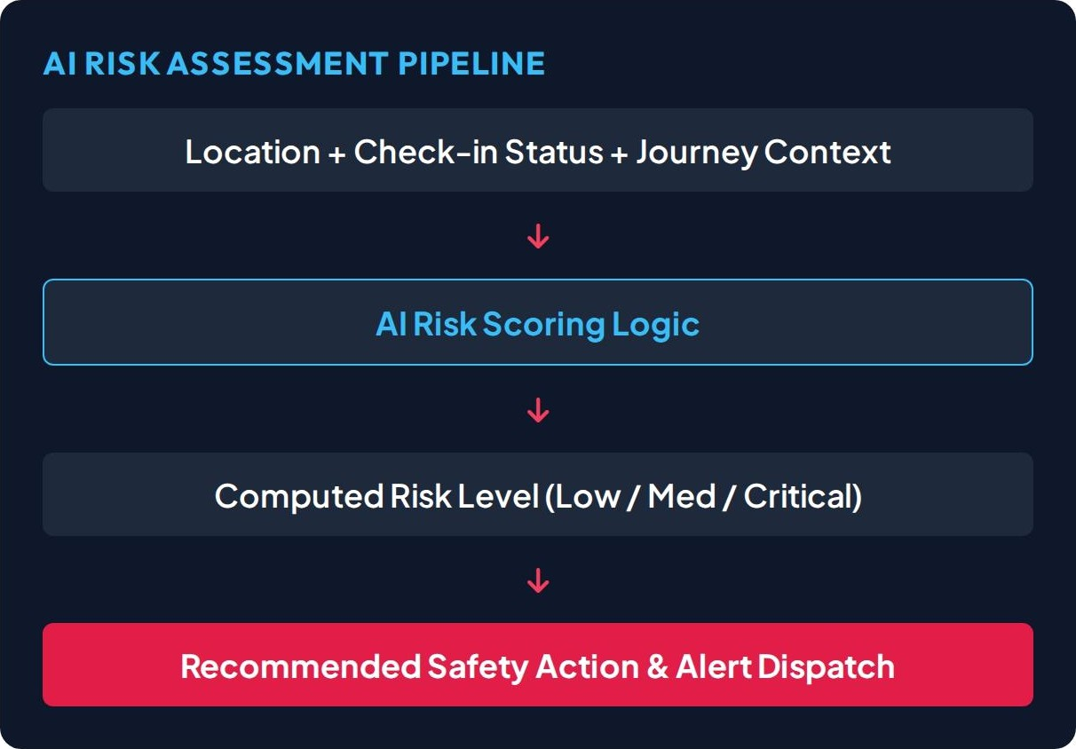
AI & Smod Safety Mechanisms
AN ALY TI CA L I NT E LLIG E NC E
Intelligence Engine
Risk Pattern Identification: Analyzes route anomalies against historical danger zones.
Behavioral Tracking: Evaluates unexpected prolonged stationary stops during transit.
Contextual Safety Scoring: Factors time of night destination safety score, & battery status.
Intelligent Assistance: AI assists safety decision-making without autonomous lockouts.
Safe Her: Al- Driven Women Safety Platf orm

Slide 9
Emergency Response Workflow
INC IDE NT ESCAL ATION
& Potential Risk/ Route Anomaly Detected
Interactive User Safety Check-in Triggered
OUser Responds "SAFE"
Reset risk timer & continue journey telemetry monitoring.
0 User Unresponsive /Timeout Exceeded
1. Automatically Elevate System Threat Level to HIGH
Broadcast SMS & Web Alerts to Emergency Contacts
Share Live Coordinates, Black Box Log & Reverse Tracking
Dispatch Spatial Distress Signal to Nearby Volunteers
Saf eHer: AI -Driven Women Safety Platf orm

Slide 10
Li4ero4ure Survey & Prior Works
AC AD E f•lI C FOU ND ATION
Academic Review
Paper Title & Authors Year / Journal Main Contribution Relevance to SofeHer
Smart Women Safety System using IoT & ML
S. Sharma, A. Kumar, P. R. Rao
2023
IEEE ICCCS
Integrated wearable IoT sensors with ML algorithms for panic motion detection.
Validates automated anomaly detection over manual distress buttons.
AI Predictive Systems for Women Safety
R. Verma, M. Mehta, N. Singh
2024
IJRIAS Journal
Evaluated AI predictive frameworks for proactive threat identification in cities.
Provides theoretical basis for SafeHer's proactive risk analysis engine.
Holistic Framework for Women's
Safety
A. Gupta, S. Deshmukh, K. Patty
2023
IEEE Access
GIS-based crime hotspot mapping combined with community volunteer alerts.
Direct foundation for safe route geofencing and community volunteer alerts.
Location-Based Safe Route Recommendation
P. K. Dash, R. N. Behera
2022
Springer LNEE
Safe route routing based on spatial density of past crime reports.
Guides SafeHerjourney monitoring & zone evaluation module.
Proactive Emergency Notification Platform
M. Patel, H. Shah, K. Joshi
2024
ACM Trans. Comput.
Timed check-ins and missed response triggers for automated SOS escalation.
Inspires SafeHer's Digital Safety Twin & timed check-in design.
Saf eHer: AI -Driven Women Safety Platform
Slide IO

Slide 11
Identified Research Gaps & Proposed Value
GAP ANA LYSI S
Comparative Study
& Limitations in Existing Solutions
Reactive Reliance: Over-dependence on physical SOS trigger buttons during high-stress encounters.
Fragmented Systems: Isolated location apps that lack integration with emergency escalation workflows.
Static Tracking: Basic one-time location pings rather than continuousjourney tracking.
Absence of Context: Inability to detect missed check-ins, delayed travel, or route deviations.
@ SofeHer Proposed Contribution
Proactive Automation: Automated escalation triggers upon missed user check-in prompts.
Unified Web Hub: Seamlessly connects telemetry, AI scoring, contacts, & volunteer dispatch.
Reverse Telemetry: Enables emergency contacts to trace back route trajectory via Black Box logs.
Contextual Intelligence: Synthesizesjourney parameters to prioritize genuine alerts.
Saf eHer: AI -Driven Women Safety Platf orm
Slide

Slide 12
Expected Outcomes & Deliverables
PROJ ECT IMPACT
Project Goals
4 Rapid Emergency Alerting
Significantly reduces emergency contact notification latency during distress situations.
e'§ Continuous Journey Awareness
Provides persistent situational awareness to authorized guardians during transit.
0 Early Threat Identification
Identifies potential risk scenarios before physical threats escalate into crises.
e Emergency Block Box Access
Preserves critical route history and incident logs for post-event analysis.
I c/ Communify Volunteer Nefwork
Mobilizes nearby registered volunteers to offer localized immediate support.
Unified Web Plofform
Delivers a platform accessible across
browsers without installation friction.
Safe Her: Al- Driven Women Safety Platf orm

Slide 13
Future System Enhancements
SC ALAB I LI TY ROAD M AP
Future Scope
Wearable IoT Integration
Voice-Activated Trigger
'o Emergency Services API
Direct dispatch integration with local police and medical emergency dispatch centers.
Connect with smartwatches and biometric bands for automated stress pulse detection.
Implement speech recognition for hands-free, voice keyword emergency activation.
Advanced Geospotiol Al
OZ Multilingual Interface
Regional language adaptation for broader usability across demographics.
Jg Zero-Knowledge Telemetry
Privacy—preserving location encryption algorithms to safeguard user travel data.
Predictive crime risk modeling leveraging dynamic spatio—temporal
datasets.
Safe Her: Al- Driven Women Safety Platf orm

Slide 14
Project Conclusion
SU Id f•l ARY
Paradigm Shift to Proactive Protection: SafeHer successfully redefines safety platforms by moving from manual panic buttons to continuous journey monitoring.
Integrated Web Solution: Built on React, Spring Boot, and PostgreSQL, providing a web-based safety platform accessible without installation hurdles.
AI-Assisted Risk Analysis: Combines route telemetry, geofences, and dynamic check-in responses to intelligently evaluate risk levels.
Automated Multi-Tier Response: Ensures timely notification dispatch to emergency contacts and nearby volunteers upon missed
check-in triggers.
Practical & Scalable Engineering: Lays a foundational architecture suitable for real-world deployment, smart city integration, and wearable expansion.
Saf eHer: AI -Driven Women Safety Platf orm

Slide 15
References & Key Bibliography
Academic Sources
S. Sharma, A. Kumar, and P. R. Rao, "Smart Women Safety System usinp loT and Machine Learning, ’ in IEEE International Conference on
R. Verma, M. Mehta, and N. Singh, "AI -Enabled Predictive Systems for Women Safety in Smart Cities," International Journal af Research
A. Gupta, S. Deshmukh, and K. Patty, ’Holistic Framework for Women s Safety: Crime Mapping and Emergency Response." IEEE
/ccess,voIl pp l420o-14218,2023.
P. K. Dash, R. N. Behera, and S. Sahoo, "Location— Based Intelligent Emergency Assistance and Safe Route Recommendation
System. 8prnge iNSJ.voL842 ppll5-l2ì2022.
M. Patel, H. Shah, and K. Joshi, ’An Automated Proactive Emergency Notification Platform for Personal Safety, ’ ACM Transactions on
Sprino Boot Documentation & React.js Technic al Architecture Speciflc ations, 2024. [Online]. Available:
https://spring.io/projects/string—boot

